Slide 1


Internship Project Presentation on “Heart Disease Analysis”
Student: Nitish K
USN : 1RN19CS092
Guide: Asst. Prof. Ms. Yashasvi B N
Department of Computer Science and Engineering
RNS Institute of Technology
2022-23

Slide 2
CONTENTS
INTRODUCTION
OBJECTIVES
PROBLEM STATEMENT
METHODOLOGY
RESULTS AND DEMONSTRATION
CONCLUSION

Slide 3
INTRODUCTION
Healthcare industries generate enormous amount of data, so called big data that accommodates hidden knowledge or pattern for decision making.
The huge volume of data is used to make decision which is more accurate than intuition.
Data analytics is considered as a cost effective technology in the recent past and it plays an essential role in healthcare which includes new research findings, emergency situations and outbreaks of disease.
The data set dates from 1988 and consists of four databases: Cleveland, Hungary, Switzerland, and Long Beach V.
It contains 76 attributes, including the predicted attribute, but all published experiments refer to using a subset of 13 of them.
The "target" field refers to the presence of heart disease in the patient. It is integer valued 0 = no disease and 1 = disease.

Slide 4
OBJECTIVES
To predict heart disease we select 13 important clinical features :
age
sex
chest pain type (4 values)
resting blood pressure
serum cholestoral in mg/dl
fasting blood sugar > 120 mg/dl
resting ecg (values 0,1,2)
maximum heart rate achieved
exercise induced angina
oldpeak = ST depression induced by exercise relative to rest
the slope of the peak exercise ST segment
number of major vessels (0-3)
thal: 0 = normal; 1 = fixed defect; 2 = reversable defect

Slide 5
PROBLEM STATEMENT
The major challenge in heart disease is its detection. Early detection of cardiac diseases can decrease
the mortality rate and overall complications. However, it is not possible to monitor patients everyday
in all cases accurately and consultation of a patient for 24 hours by a doctor is not available since it
requires more patience, time and expertise. Since we have a good amount of data in today’s world,
we can use various machine learning algorithms to analyze the data for hidden patterns. The hidden
patterns can be used for health diagnosis in medicinal data by using machine learning algorithms and data
analysis.

Slide 6
METHODOLOGY
Heart disease analysis using machine learning typically involves the following methodology:
Data collection: The first step is to collect relevant data on heart disease, including patient information such as age, gender, medical history, and diagnostic test results.
Data preprocessing: The collected data needs to be preprocessed to ensure that it is clean, complete, and ready for analysis. This involves tasks such as data cleaning, normalization, feature selection, and dimensionality reduction.
Feature identification: In this step, relevant features are identified from the preprocessed data. This is done by analyzing the statistical properties of the data, identifying correlations between variables, and selecting the most relevant features.
Model selection: The next step is to select an appropriate machine learning model for the analysis. This can include models such as logistic regression, decision trees, random forests, or neural networks. We selected logistic regression model for this project.

Slide 7
METHODOLOGY
Model training: Once the model is selected, it needs to be trained using the preprocessed data. This involves splitting the data into training and validation sets, fitting the model to the training data, and evaluating its performance on the validation set. We stored the trained model into a pickle file.
Model evaluation: After training the model, its performance is evaluated using metrics such as accuracy, precision, recall, and F1 score. Accuracy score using Logistic Regression was : 83.61%
Model deployment: The final step is to deploy the trained model in a real-world setting for heart disease analysis. This can involve integrating the model into a clinical decision support system or a mobile application, web apps for patients. We deployed a web app using streamlit framework on Heroku.

Slide 8
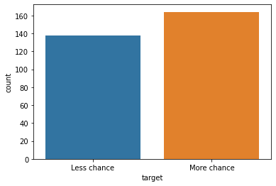
RESULTS AND DEMONSTRATION
The total count of heart disease less chance vs more chance:

Slide 9
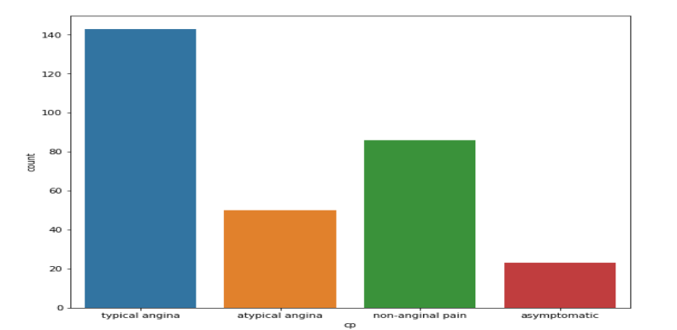
RESULTS AND DEMONSTRATION
The total count of chest pain in dataset:

Slide 10
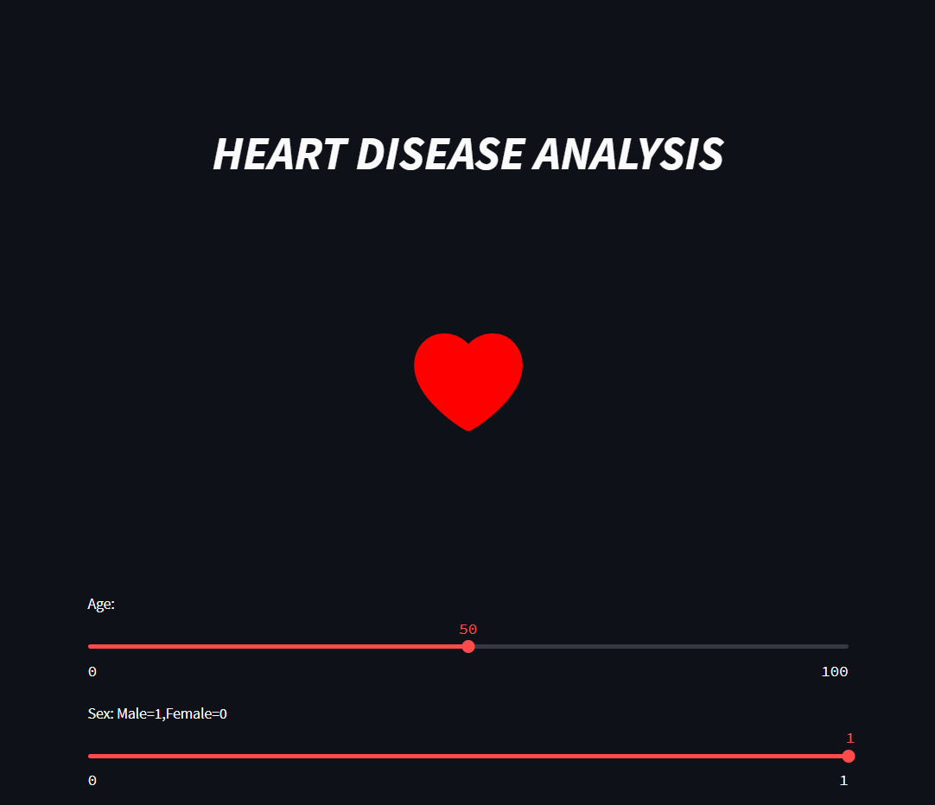
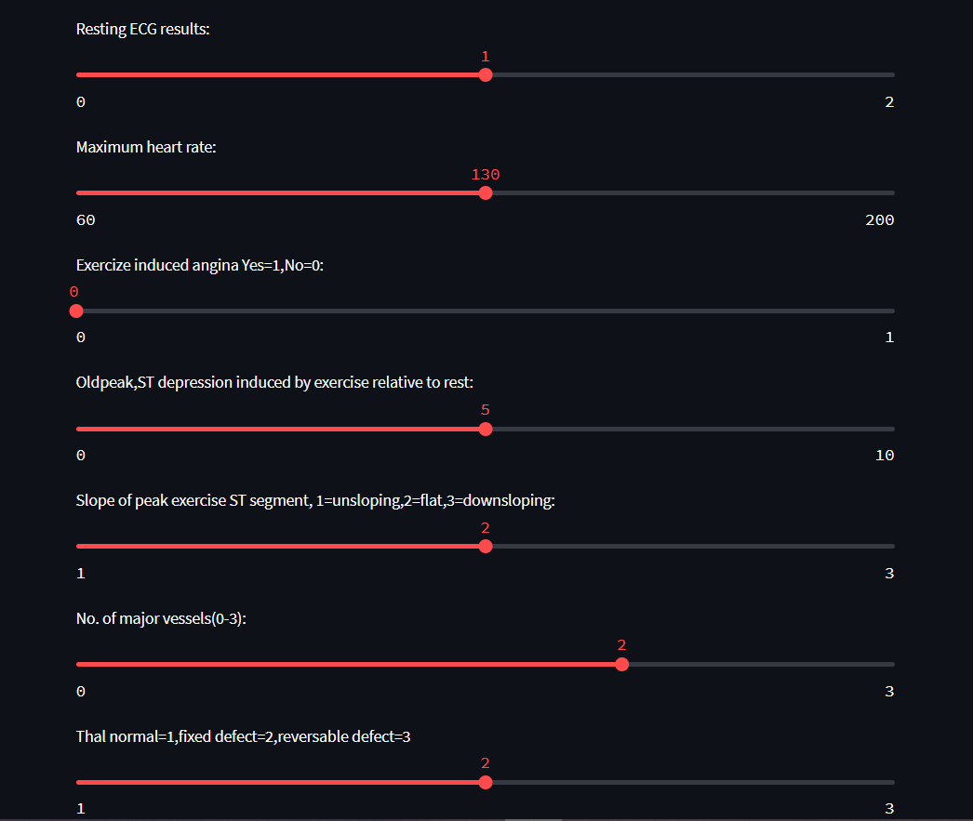
RESULTS AND DEMONSTRATION
Streamlit web-app:

Slide 11
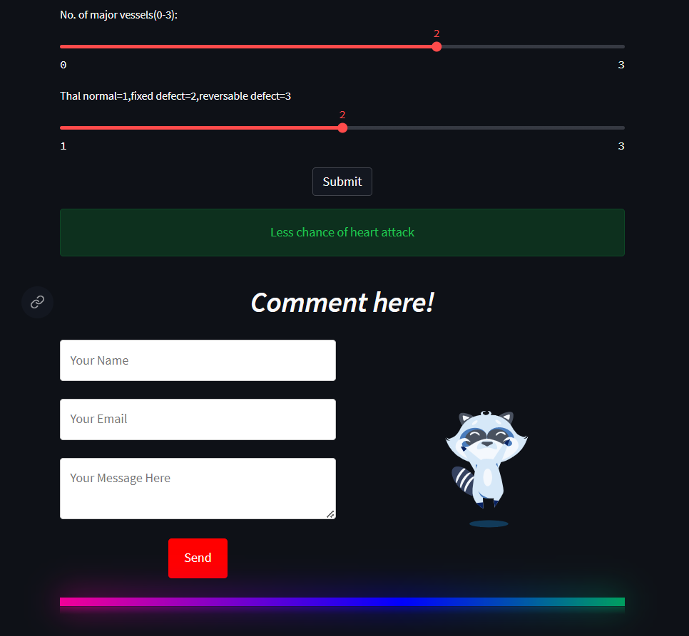
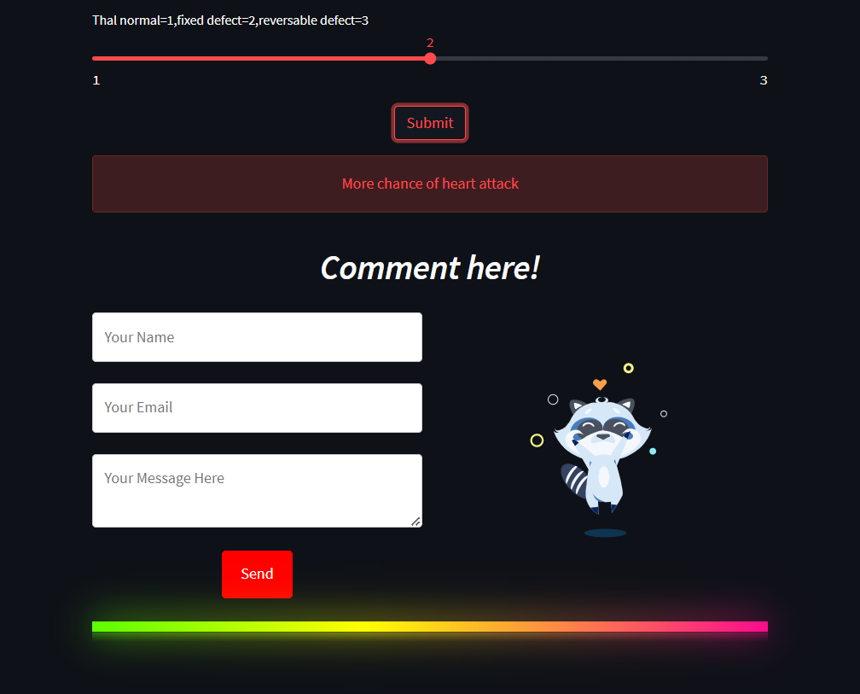
RESULTS AND DEMONSTRATION
Streamlit web-app prediction if heart attack chances are less or more for a given data :

Slide 12
CONCLUSION
Heart diseases are a major killer in India and throughout the world, application of promising technology like machine learning to the initial prediction of heart diseases will have a profound impact on society. The early prognosis of heart disease can aid in making decisions on lifestyle changes in high-risk patients and in turn reduce the complications, which can be a great milestone in the field of medicine. The number of people facing heart diseases is on a raise each year. This prompts for its early diagnosis and treatment. The utilization of suitable technology support in this regard can prove to be highly beneficial to the medical fraternity and patients. In this report, the two different machine learning algorithms used to measure the performance are Decision Tree and Logistic Regression applied on the dataset. The visualization of the dataset has been done using tableau.

